Slide 1
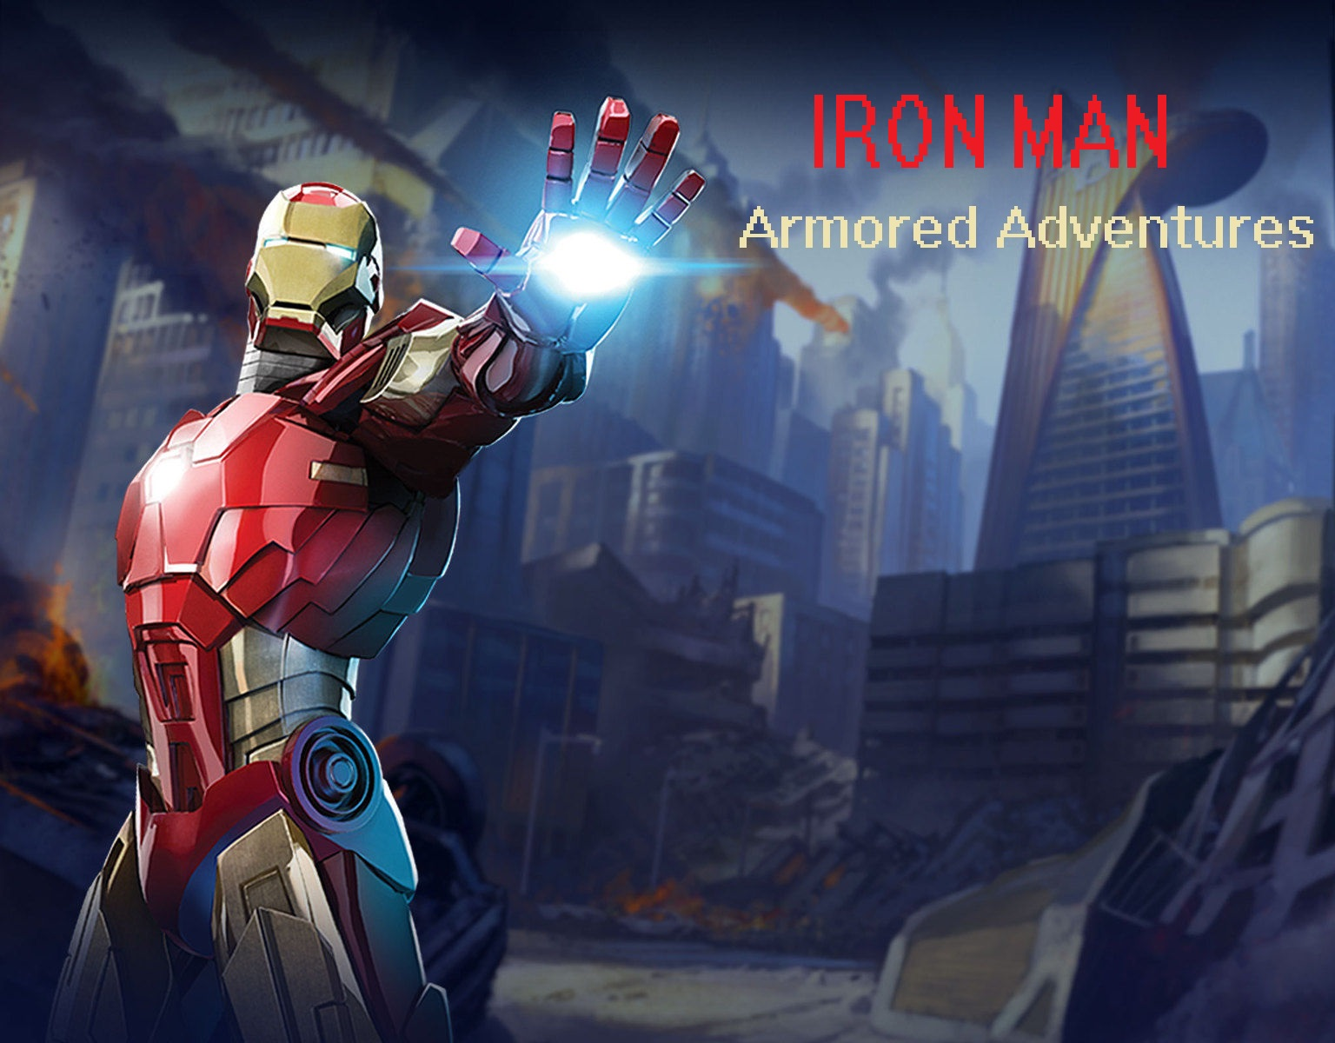
Team-Monstars
Avni Gulati
Ishwarya Varadarajan
Rucha Apte
Sowmya Gowrishankar
Sowmya Viswanathan

Slide 2
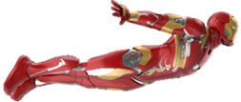
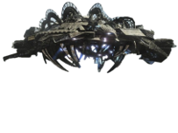
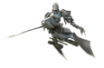
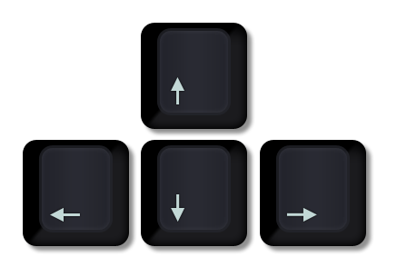



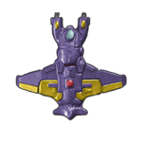

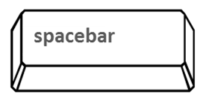


How to Play?
Player
Enemies
Move up down left right
Using the keyboard buttons
Kill them all!!
Shoot with space bar
Get Bonus Shots
Get Bonus Life

Slide 3
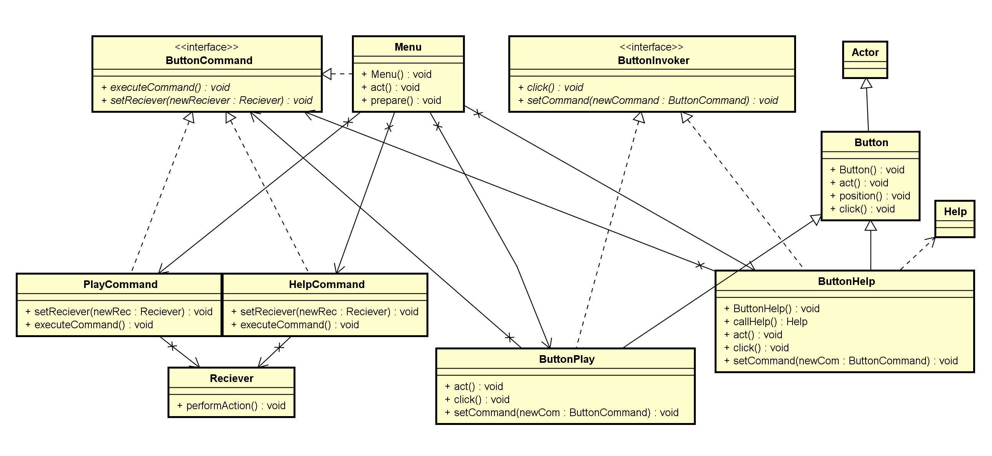
COMMAND PATTERN

Slide 4
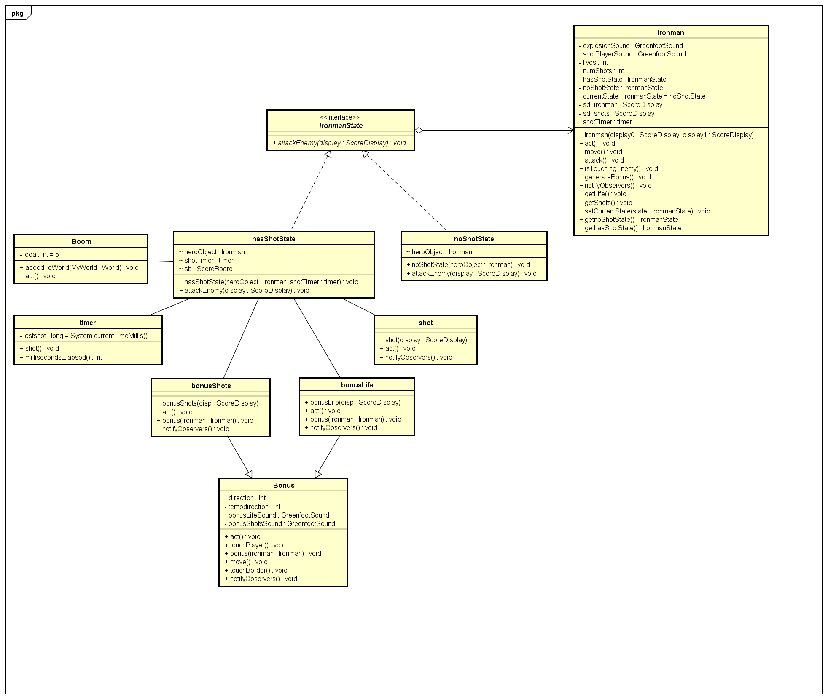
STATE PATTERN

Slide 5
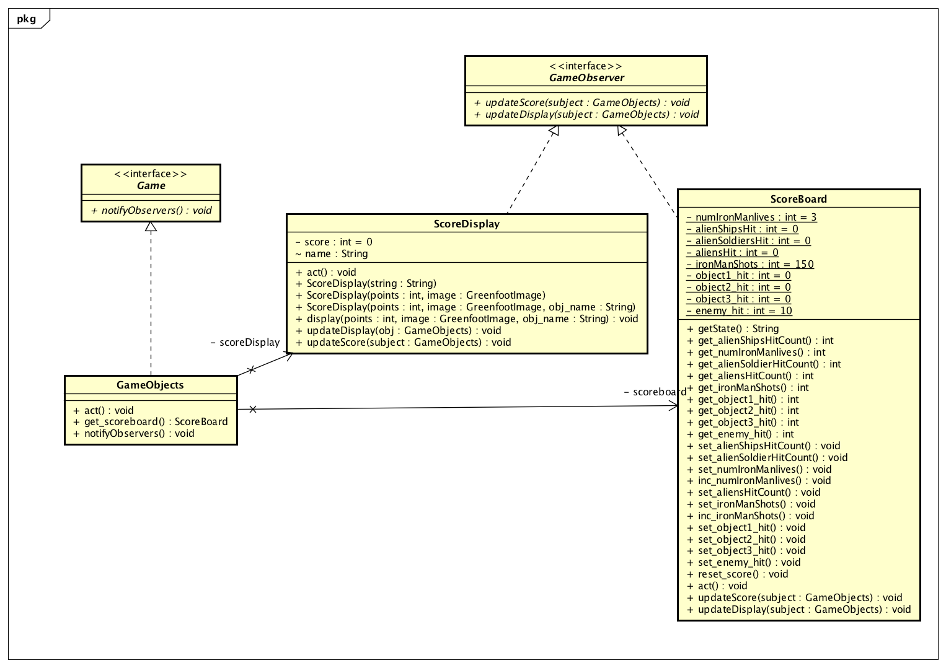
OBSERVER PATTERN

Slide 6
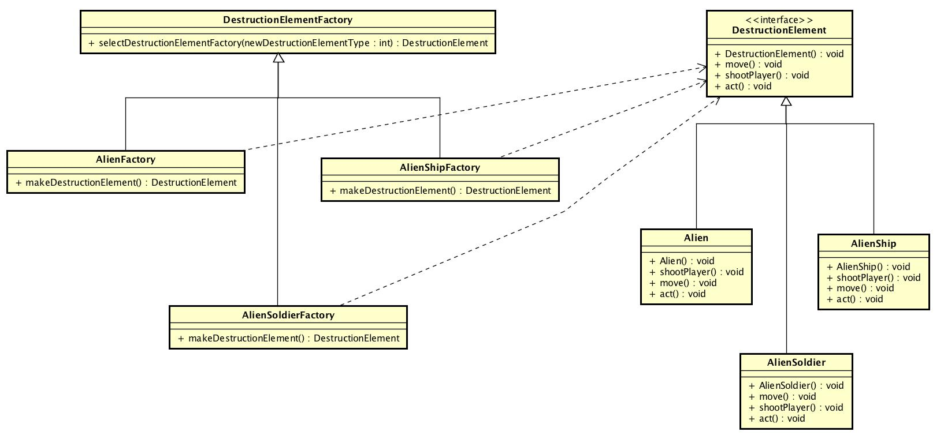
FACTORY PATTERN

Slide 7
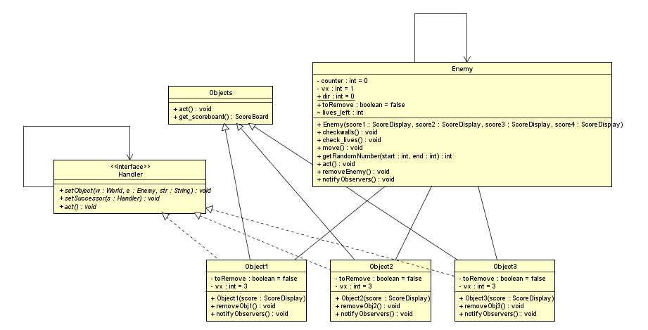
CHAIN OF RESPONSIBILITY PATTERN

Slide 8
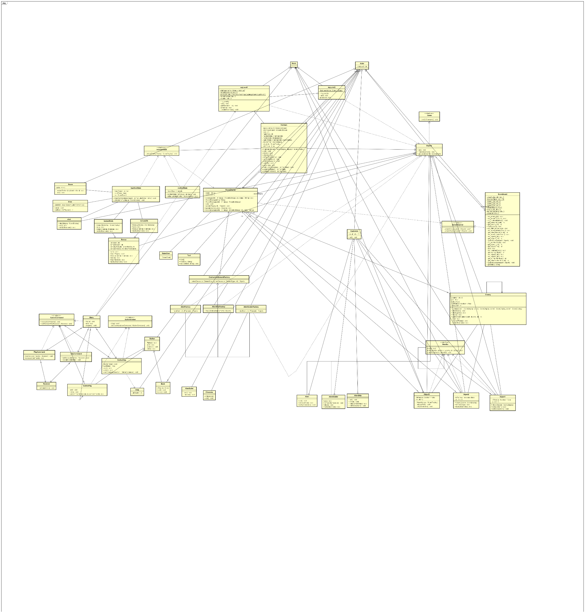
CLASS DIAGRAM

Slide 9
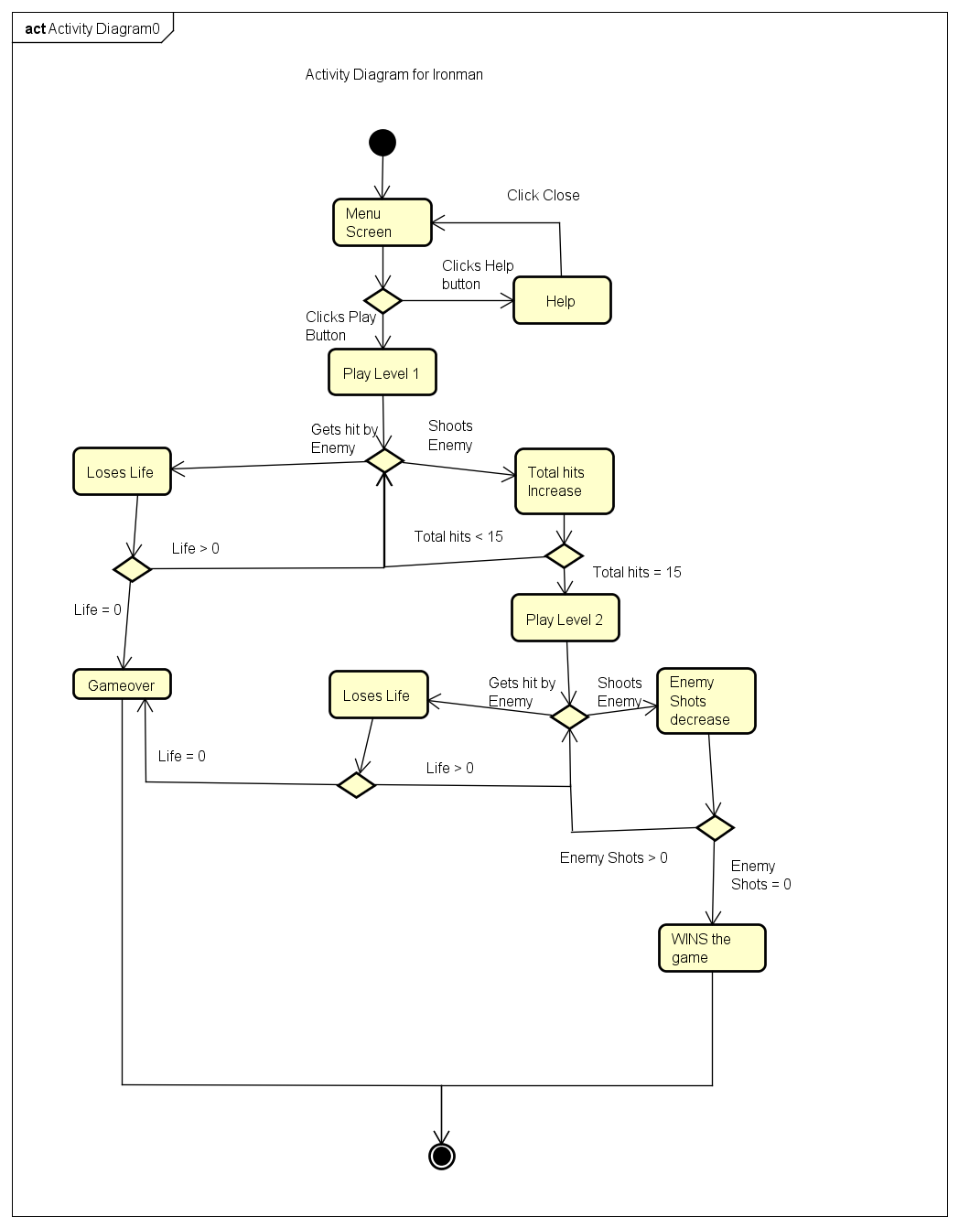
ACTIVITY DIAGRAM

Slide 10
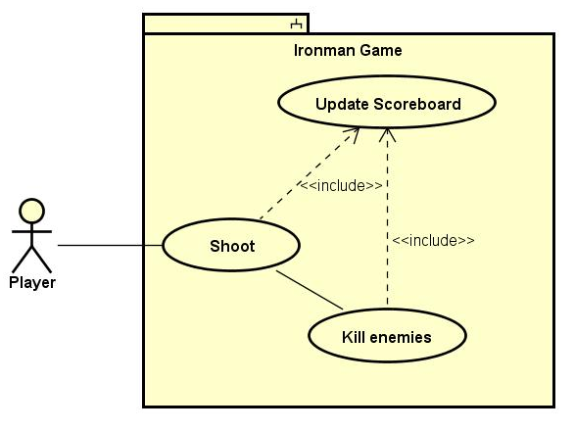
USE CASE SPECIFICATION
USE CASE DIAGRAM
USE CASE DESCRIPTION
Use Case Name | Kill Enemies
Related Requirements | The player should be able to shoot to kill enemies.
Goal In Context | The player shoots and kills all the enemies.
Preconditions | The game has been started. There are enemies yet to be killed.
Successful End Condition | The player shoots and kills at least one enemy.
Failed End Condition | The player gets hit by the enemy. Number of lives gets reduced and if the number of lives becomes 0, player gets killed. Game gets over
Primary Actors | Ironman Enemy objects Shots
Secondary Actors | Scoreboard
Trigger | The player starts shooting
Main Flow | Step | Action
 | 1 include::Update Scoreboard | The player starts shooting and the scoreboard gets updated with the number of shots left.
 | 2 | The shot hits the enemy object.
 | 3 include::Update Scoreboard | The enemy object gets killed and the scoreboard gets updated with the number of enemy objects killed.
Extensions | Step | Branching Action
 | 1.1 | The player is not able to shoot as there are no more shots left to shoot.
 | 2.1 | The enemy object hits the player and the number of lives gets reduced.

Slide 11
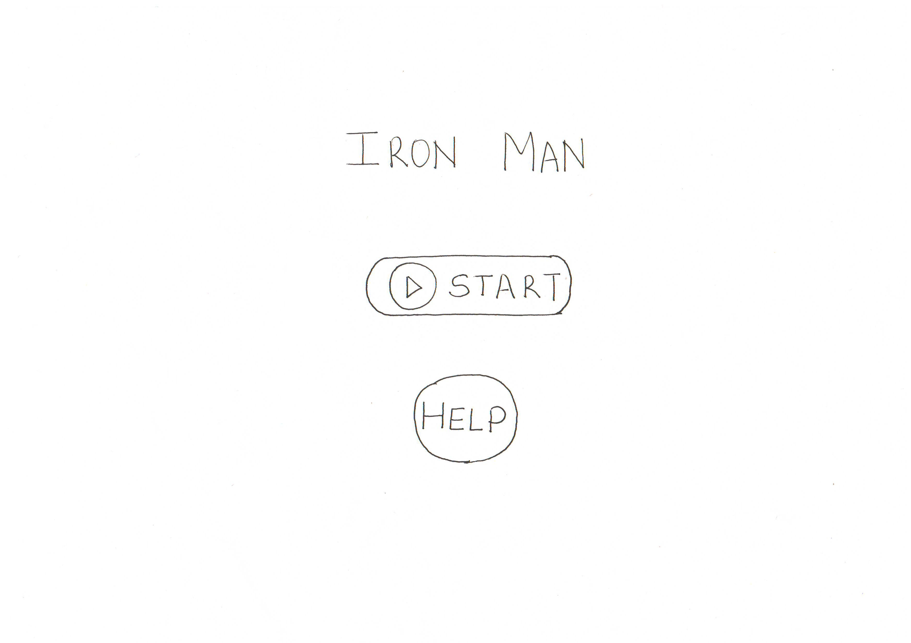
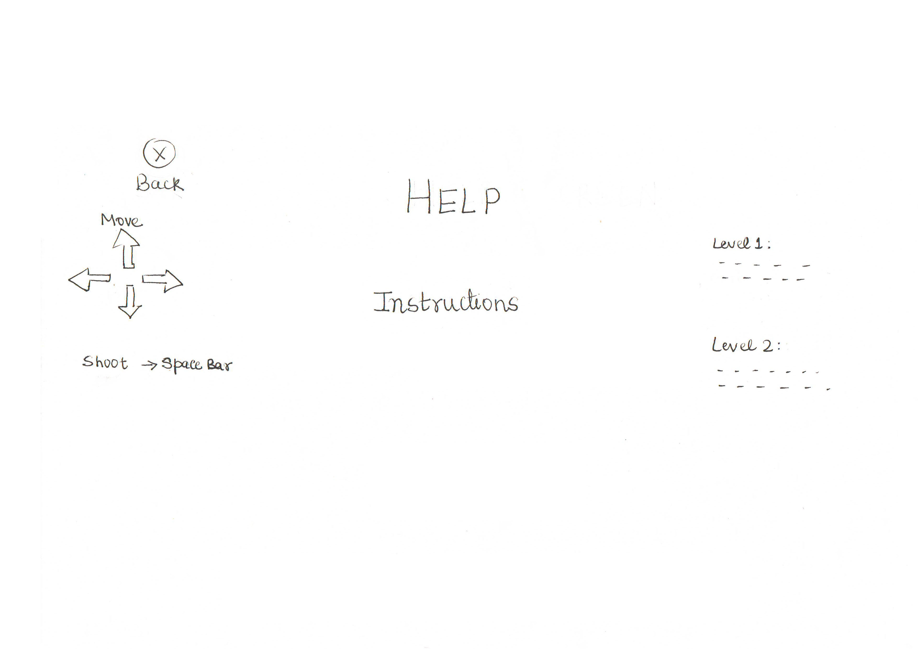
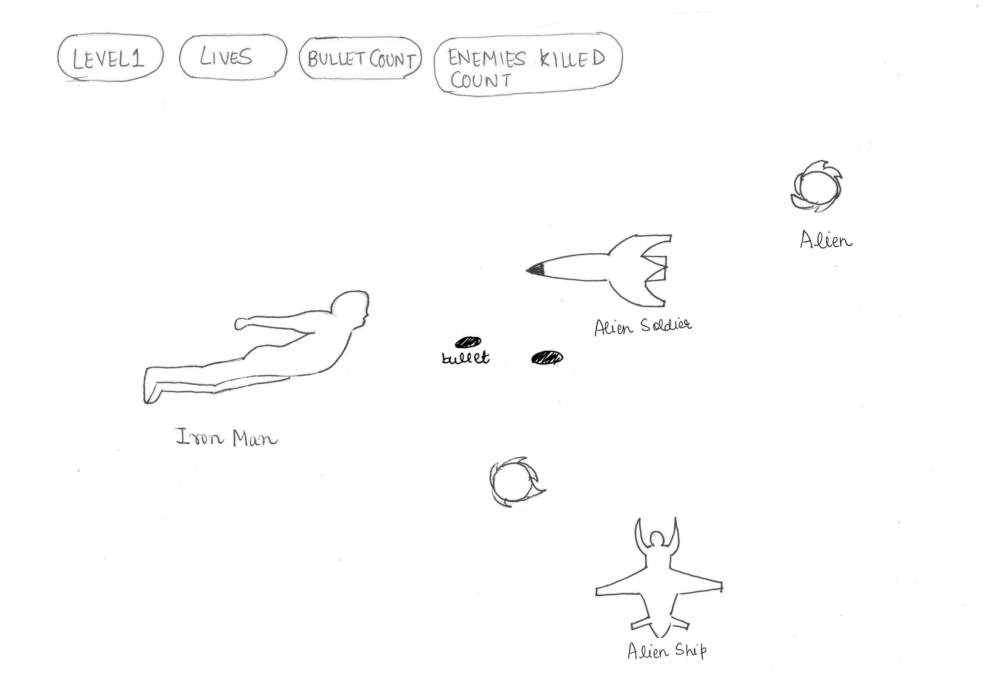

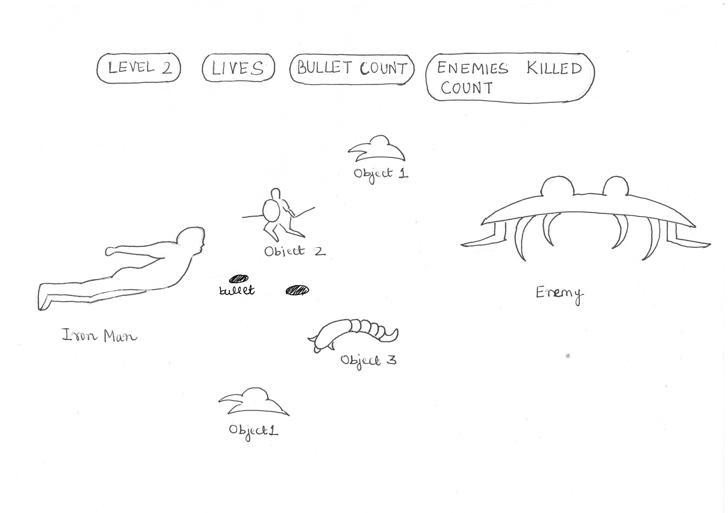
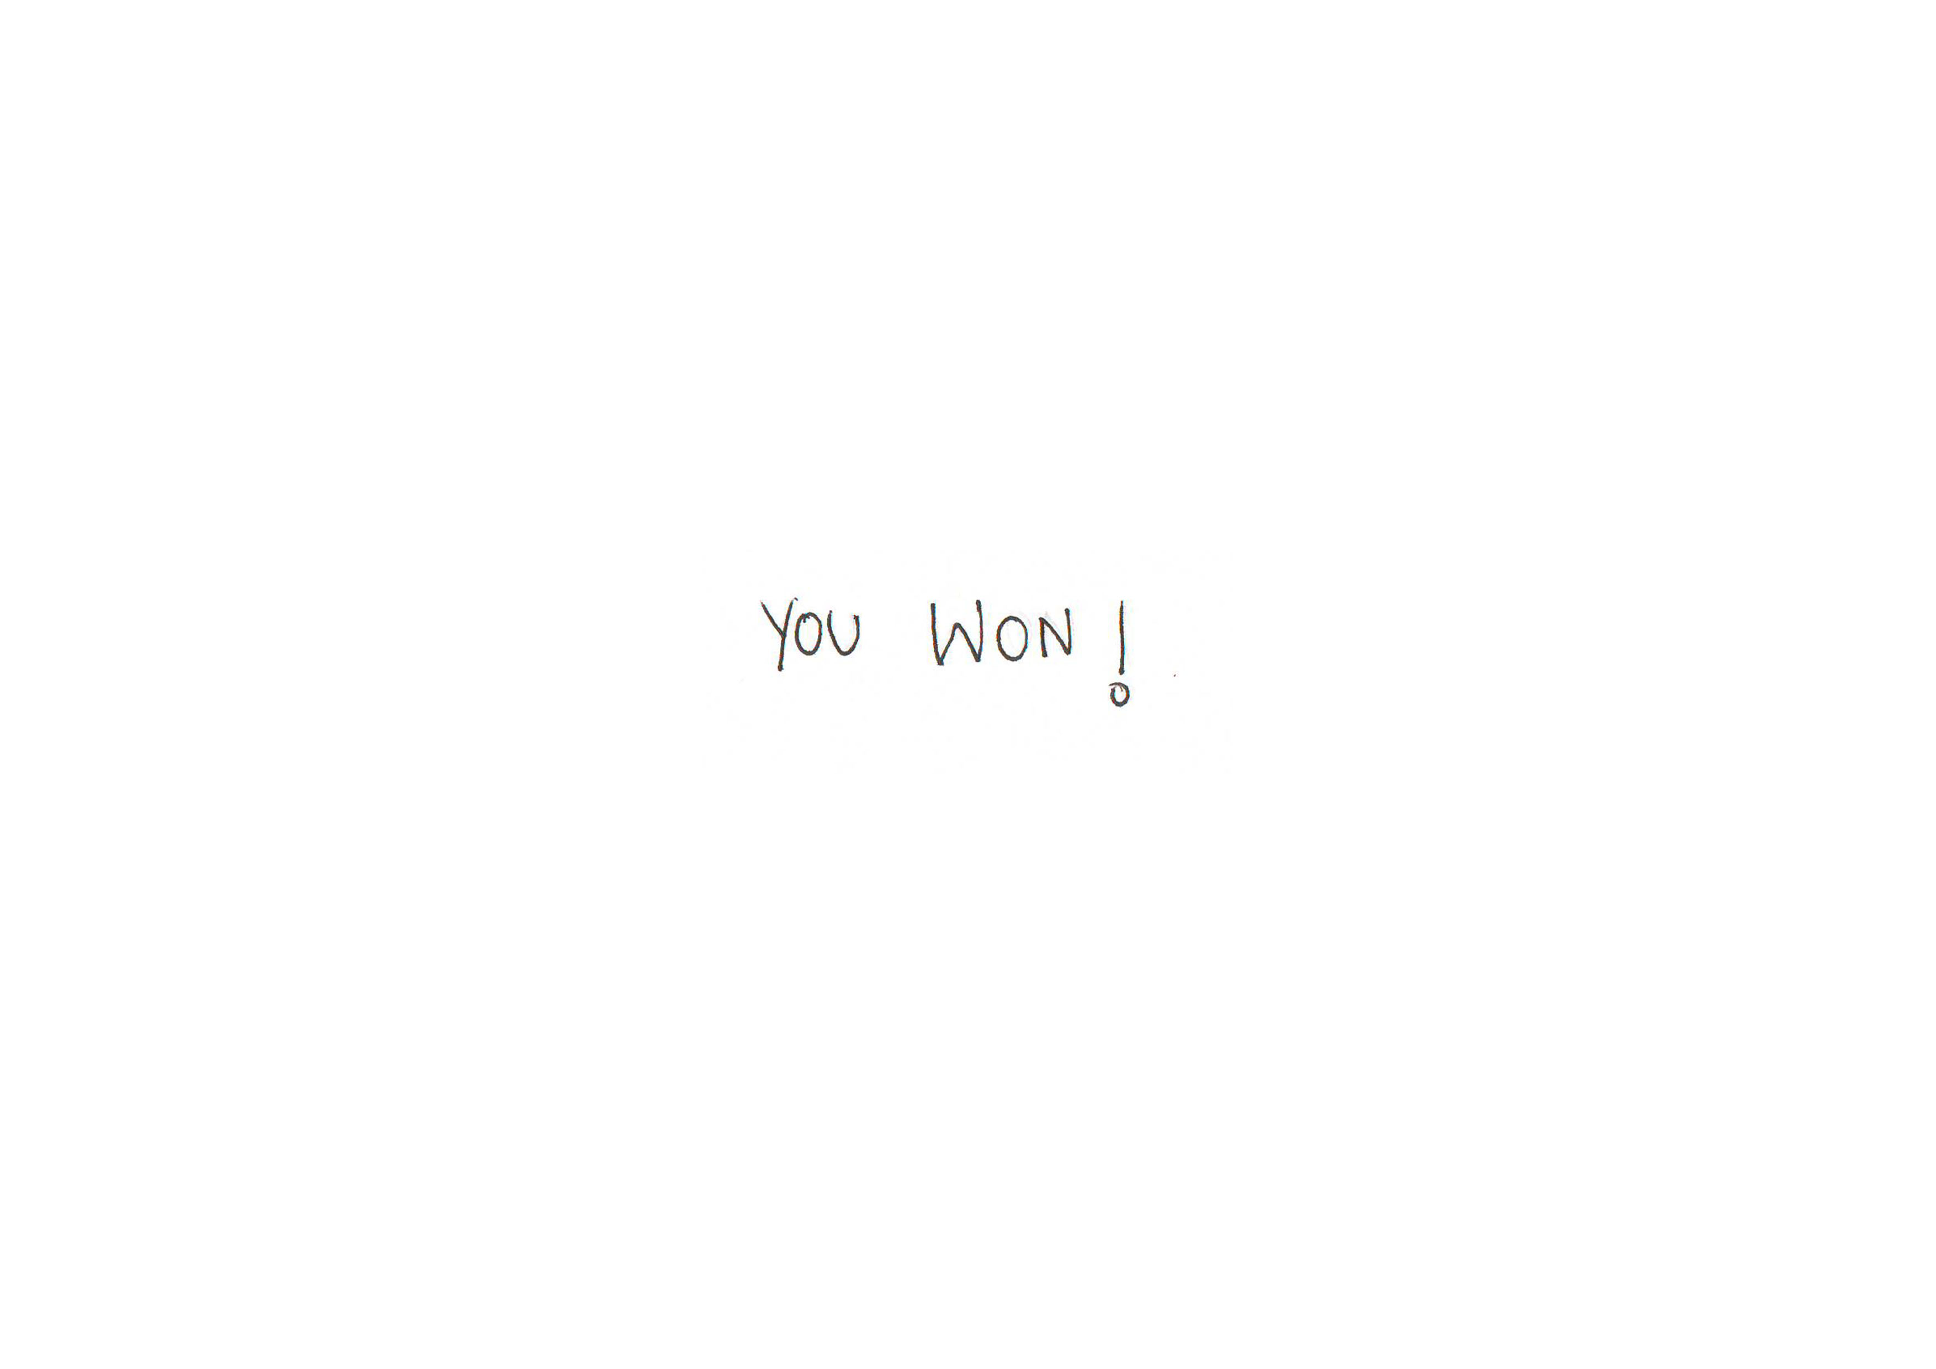
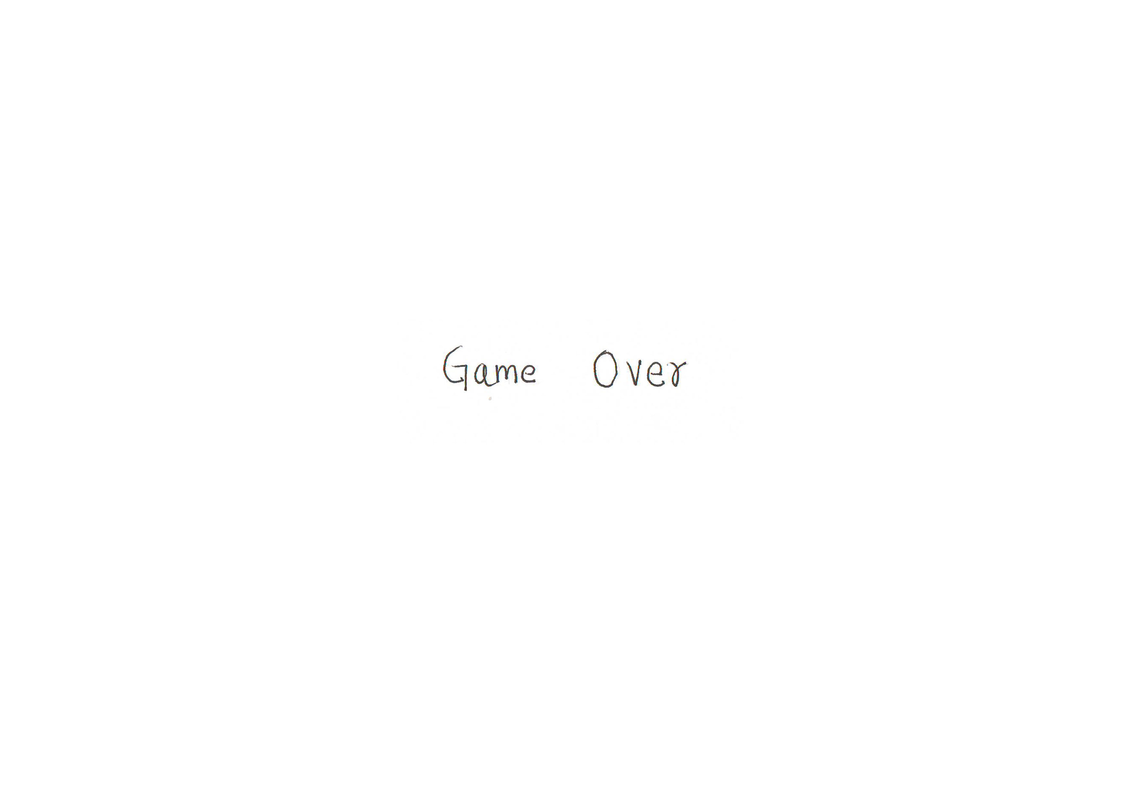
UI Wireframe

Slide 12
CUMULATIVE FLOAW DIAGRAM

Slide 13
SCRUM BURNDOWN CHART

Slide 14
PROJECT RETROSPECTIVES
What was good?
What was bad?
The game worked as expected.
Frequent collaboration and good team work.
Implementation using Scrum and Kanban methodologies
Scrum – with number of hours estimated for each task – was more useful and efficient
Initial time taken in understanding the design patterns and integrating in our game
Machine dependent issues
Ideas?
Make the game accessible from a browser.
Implement Kinect.
Multiplayer game.

Slide 15
Thank You

